Slide 1

What can security consultants learn from how police solve problems?
Department of Security and Crime Science

Slide 2

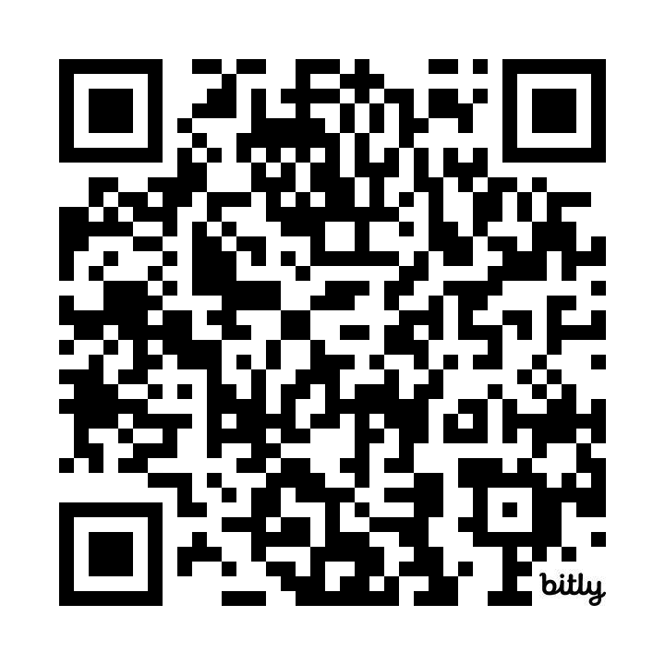

Slide 3

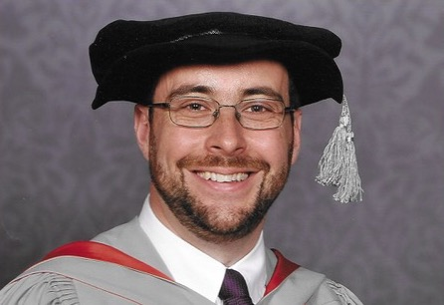
My career in two pictures

Slide 4
Problem solving
“the systematic identification of
repeat … recurring problems
that affect the community and …
produce heavy demands on police”
your client
Source: A Sidebottom. 2020. Successful police problem-solving: a practice guide. London: UCL Jill Dando Institute.

Slide 5
How police solve problems
Scanning: define the problem
Analysis: understand the problem in detail
Response: take action to solve the problem
Assessment: establish if the problem is solved

Slide 6
S
Use of cloned debit cards in local ATMs
A
Cards details are being obtained from cards at local gas stations by employees who owe money to a gang
R
Short term: covert observations to identify staff
Long term: work with gas-station owners to better secure payment terminals against fraud by staff
A
Monitor number of crimes being reported to banks or police

Slide 7
“[problem solving] produced a larger overall [reduction in crime] … twice the size of the increased traditional policing”
Source: A Braga, A Papachristos & D Hureau. 2014. The Effects of Hot Spots Policing on Crime. Justice Quarterly 31(4):633–663.

Slide 8
1
Be specific

Slide 9
The more specific the problem, the easier it will be to solve

Slide 10
Robbery
Commercial robbery
Personal robbery
Liquor-store robbery
Cash-in-transit robbery
…
Home invasion
Car-jacking
Phone robbery
…
Outside metro stations
Outside schools
Late at night
…

Slide 11
2
Seriously, be much more specific

Slide 12
Phone robberies outside nightclubs
Phone robberies outside a specific nightclub just after closing time
Phone robberies within 200m of a specific nightclub just after closing time by offenders from a local housing project riding dirt bikes

Slide 13
3
Make (a little) time for analysis

Slide 14
How police solve problems
Scanning: define the problem
Analysis: understand the problem in detail
Response: take action to solve the problem
Assessment: establish if the problem is solved

Slide 15
In what way is the problem most concentrated?

Slide 16
offenders
targets
places

Slide 17
Repeat offending
Journey to crime
Facilitators
Social networks
Intelligence interviews
Repeat victimization
Near-repeat victimization
Victim–offender overlap
offenders
targets
Hotspots
Place managers
places

Slide 18
At which point in the problem is it easiest to intervene?

Slide 19
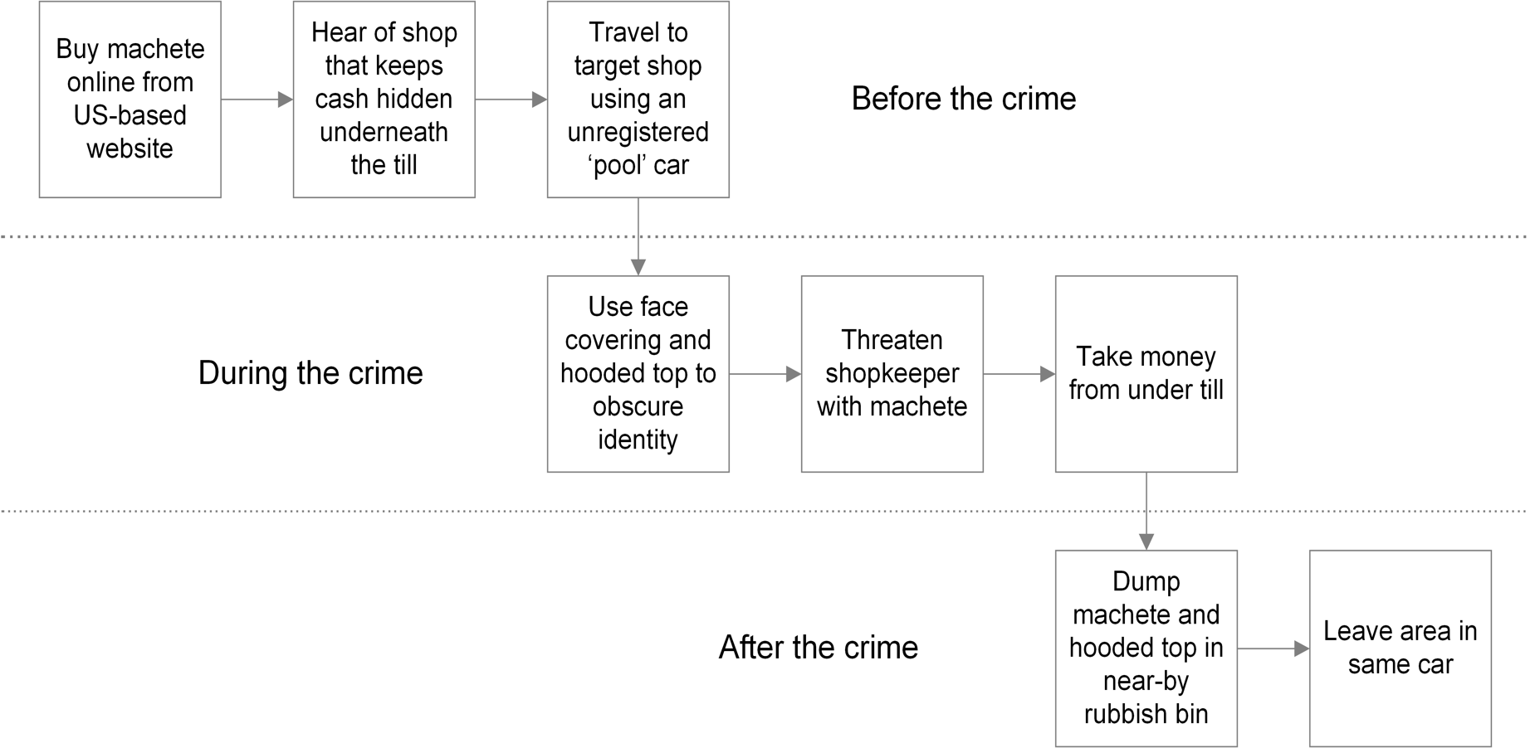

Slide 20
4
Use existing evidence

Slide 21
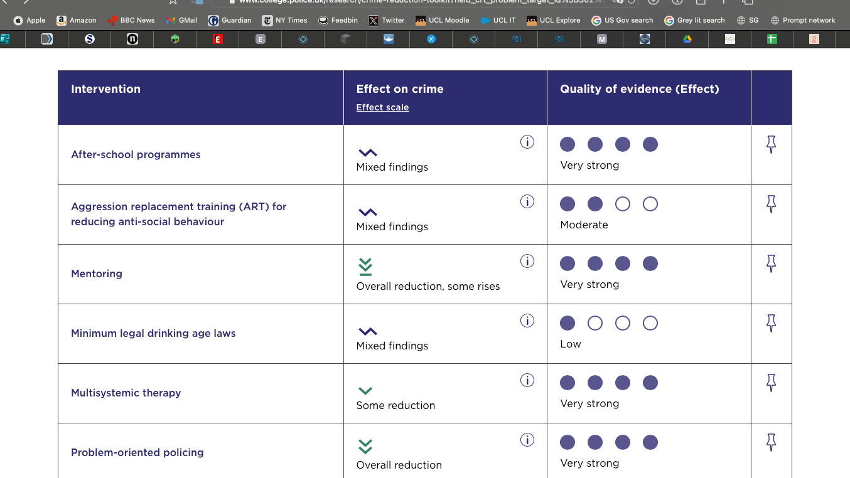
College of Policing Crime Reduction Toolkit

Slide 22
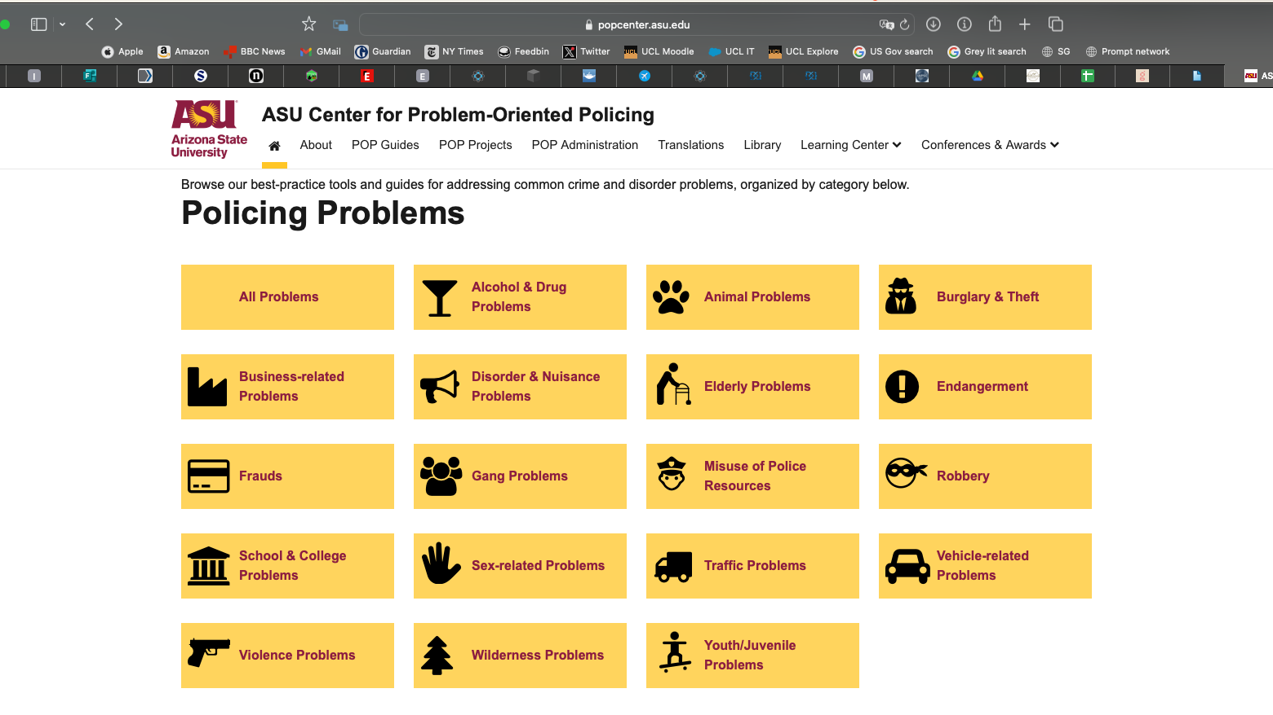
Arizona State University Center for Problem-Oriented Policing

Slide 23
5
Make use of practical psychology

Slide 24
The easier something is to do, the more people will do it

Slide 25
People prioritise short-term outcomes over long-term ones

Slide 26
Most people are bad at intuitively estimating risk

Slide 27

Practical Psychology for Policing by Prof Jason Roach

Slide 28
6
Changing environments works better than trying to change people

Slide 29
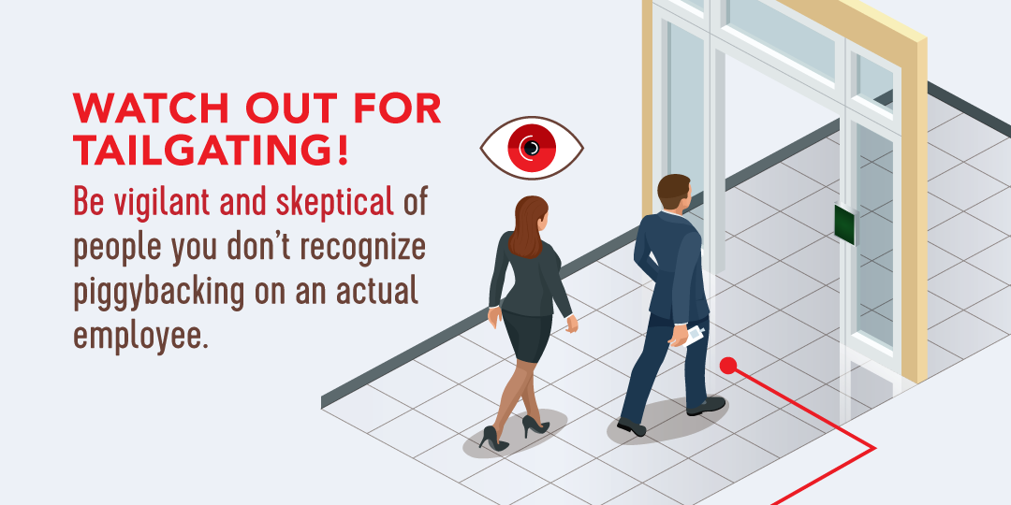
Image: ISC Events

Slide 30
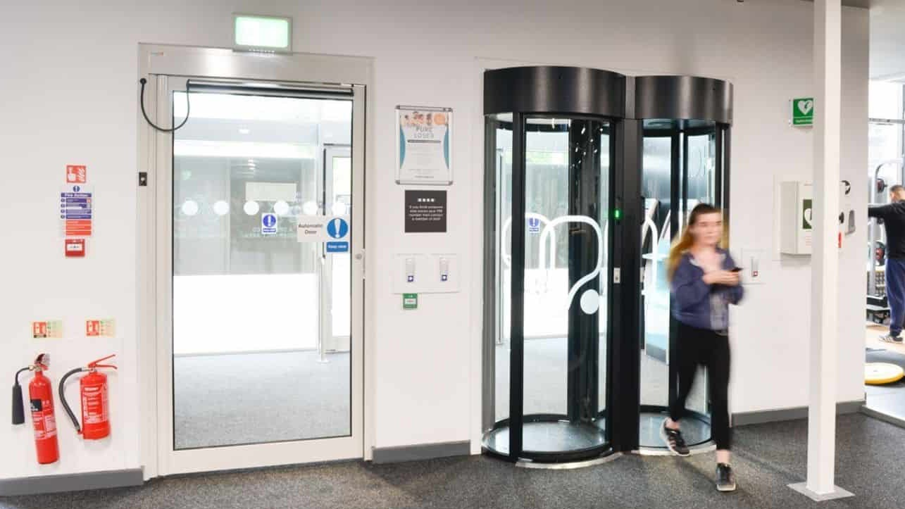
Image: Meesons

Slide 31
7
Have a short-term and a long-term response

Slide 32
Priority: rapid implementation
scanning
short-term response
analysis
response
long-term response
Priority: sustainability

Slide 33

Image: Omar Burgos Dättwyler

Slide 34
8
Ask yourself: what has to happen for my plan to work?

Slide 35
Action
Mechanism
Effect
Liquor store moves expensive whisky behind register
Shoplifters cannot reach expensive whisky
Less expensive whisky is stolen

Slide 36
Action
Mechanism
Effect
Surveillance cameras
?
Less expensive whisky is stolen

Slide 37
9
Ask yourself: what might stop my plan from working?

Slide 38
Liquor store moves expensive whisky behind register
Shoplifters cannot reach expensive whisky
Less expensive whisky is stolen

Slide 39
10
Measure achievement, not just activity

Slide 40
★☆☆☆☆
3 days of action
★★☆☆☆
5 people prosecuted
★★★★☆
50% reduction in crime

Slide 41

Slides + links
lesscrime.info/talk/iapsc-problem-solving
Get in touch matthew.ashby@ucl.ac.uk
@lesscrime

